Slide 1
Model Conversion from LTSpice to Simscape
| Zackery Miller | 05/31/2022

Slide 2
Conversion process

Slide 3
Conversion Overview and Requirements
Details the necessary set-up for conversion to occur
Will need to have the Simscape toolbox installed on local machine (or available license in online version)
Need the .lib file of the desired model provided by Wolfspeed
  ‘model.lib’ must be renamed to ‘model.cir’
Conversion involves using these two functions:
  subcircuit2ssc(‘model.cir’,’+model_library’)
    Converts subcircuit model to simscape-component
  ssc_build model_library
    Builds the component library for use in the Simulink/Simscape environment

Slide 4


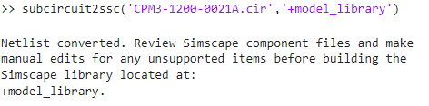
Conversion Process
Detailed step-by-step model conversion procedure
Rename model File
MATLAB Path
Subcircuit conversion
MATLAB only accepts model files of ‘.cir’ type, so the ‘.lib’ must be renamed
Ensure that the model is in the current folder/working path for MATLAB
Uses the subcircuit2ssc() function to convert model file to simscape component and stores it in “+model_library” folder

Slide 5
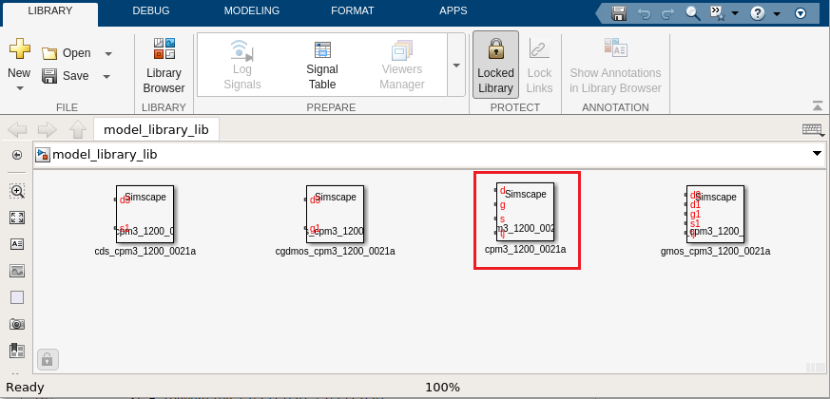
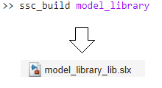
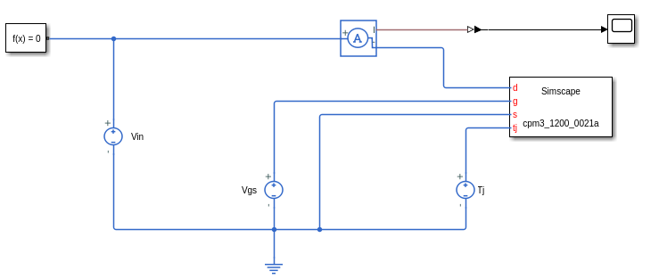
Conversion Process
Conversion Process
Build Component Library
Model component Library
Example Circuit
The ssc_build command will build the custom model_library as ‘model_library_lib.slx’
The model conversion will produce the library above. The four subcircuits are the whole model and the model_block is used for the simulation
Example circuit to test IV operation of device. Note that Simscape required f(x)=0 Solver configuration

Slide 6
Model Configuration

Slide 7
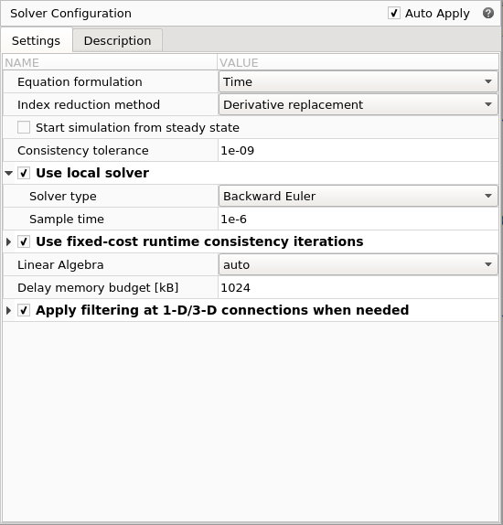
Configuration and Convergence issues
Details Simscape Configuration requirements
Wolfspeed Simscape models are sensitive to solver settings in Simulink
Solver Configuration Block needs to be updated with appropriate settings, otherwise model will run into solver issues
  Needs to inherit local settings
  Sample Rate needs to be consistent with simulation time-step (i.e simulation length or simulated frequencies)
  Solver Type should be Backward Euler
Further convergence issues can be solved by editing solver min and max time-steps and relative tolerance thresholds in Simulink

Slide 8
Thank you

